Slide 1


Platform for Overdue Receivables
Connecting Sellers and Buyers
Eppu Hassinen
Jarmo Tahvanainen
Risto Teerikoski
Notes:
Slide 1: Title Slide Hi, I’m [Your Name], and I’m here to introduce BidWise, a platform to trade overdue receivables.

Slide 2


The Problem
Customers not paying their invoices is a huge problem. Money is stuck with them.
Large companies can sell overdue receivables to improve cash flow.
For smaller companies selling receivables is almost impossible.
Selling receivables is a growing trend with significant potential for smaller companies.
BidWise makes selling and buying unpaid invoices easy.
Notes:
First of all, our team has a great experience in debt collection and debt purchasing.
For companies of all sizes, customers not paying their invoices is a huge problem,
and while larger companies can sell their overdue receivables to improve their cash flow,
smaller companies still need to use traditional debt collection services to collect their receivables.
However, selling receivables is becoming a more frequently used solution. This trend has a great potential especially for smaller companies.
That’s where BidWise comes in — helping companies of all sizes to sell or buy overdue receivables.

Slide 3














Sellers & Buyers
Notes:
This slide shows examples from our two key groups:
sellers, on the left, the ones with overdue receivables, and
buyers, on the right, searching for receivable portfolios to buy.
BidWise connects these groups for easier and faster transactions.

Slide 4







Sellers
Buyers
What a mess!
Current way
Where are all the buyers?
There’s gotta be an easier way?
Where dem’ portfolios!
Notes:
This is the current way of selling and buying overdue receivables.
For sellers, selling overdue receivables for quick cash flow is complicated. And also buyers struggle to find opportunities.
The current process is slow, unclear, and frustrating for both sides, showing the need for a simple and fast solution.

Slide 5









Introducing BidWise
Upload
Wait for offers
Browse offers
Get money
Steps for Sellers:
Steps for Buyers:
Browse
Evaluate
Make offers
Purchase invoices
Notes:
Introducing BidWise
BidWise is a platform that connects sellers and buyers, making the process of managing overdue receivables simple and fast.
For sellers, it offers a fast way to get immediate cash flow instead of waiting years to collect payments. Companies of all sizes can easily sell their receivables and find the best price.
For buyers, BidWise provides easy access to new opportunities across multiple countries with a streamlined process that saves time.

Slide 6
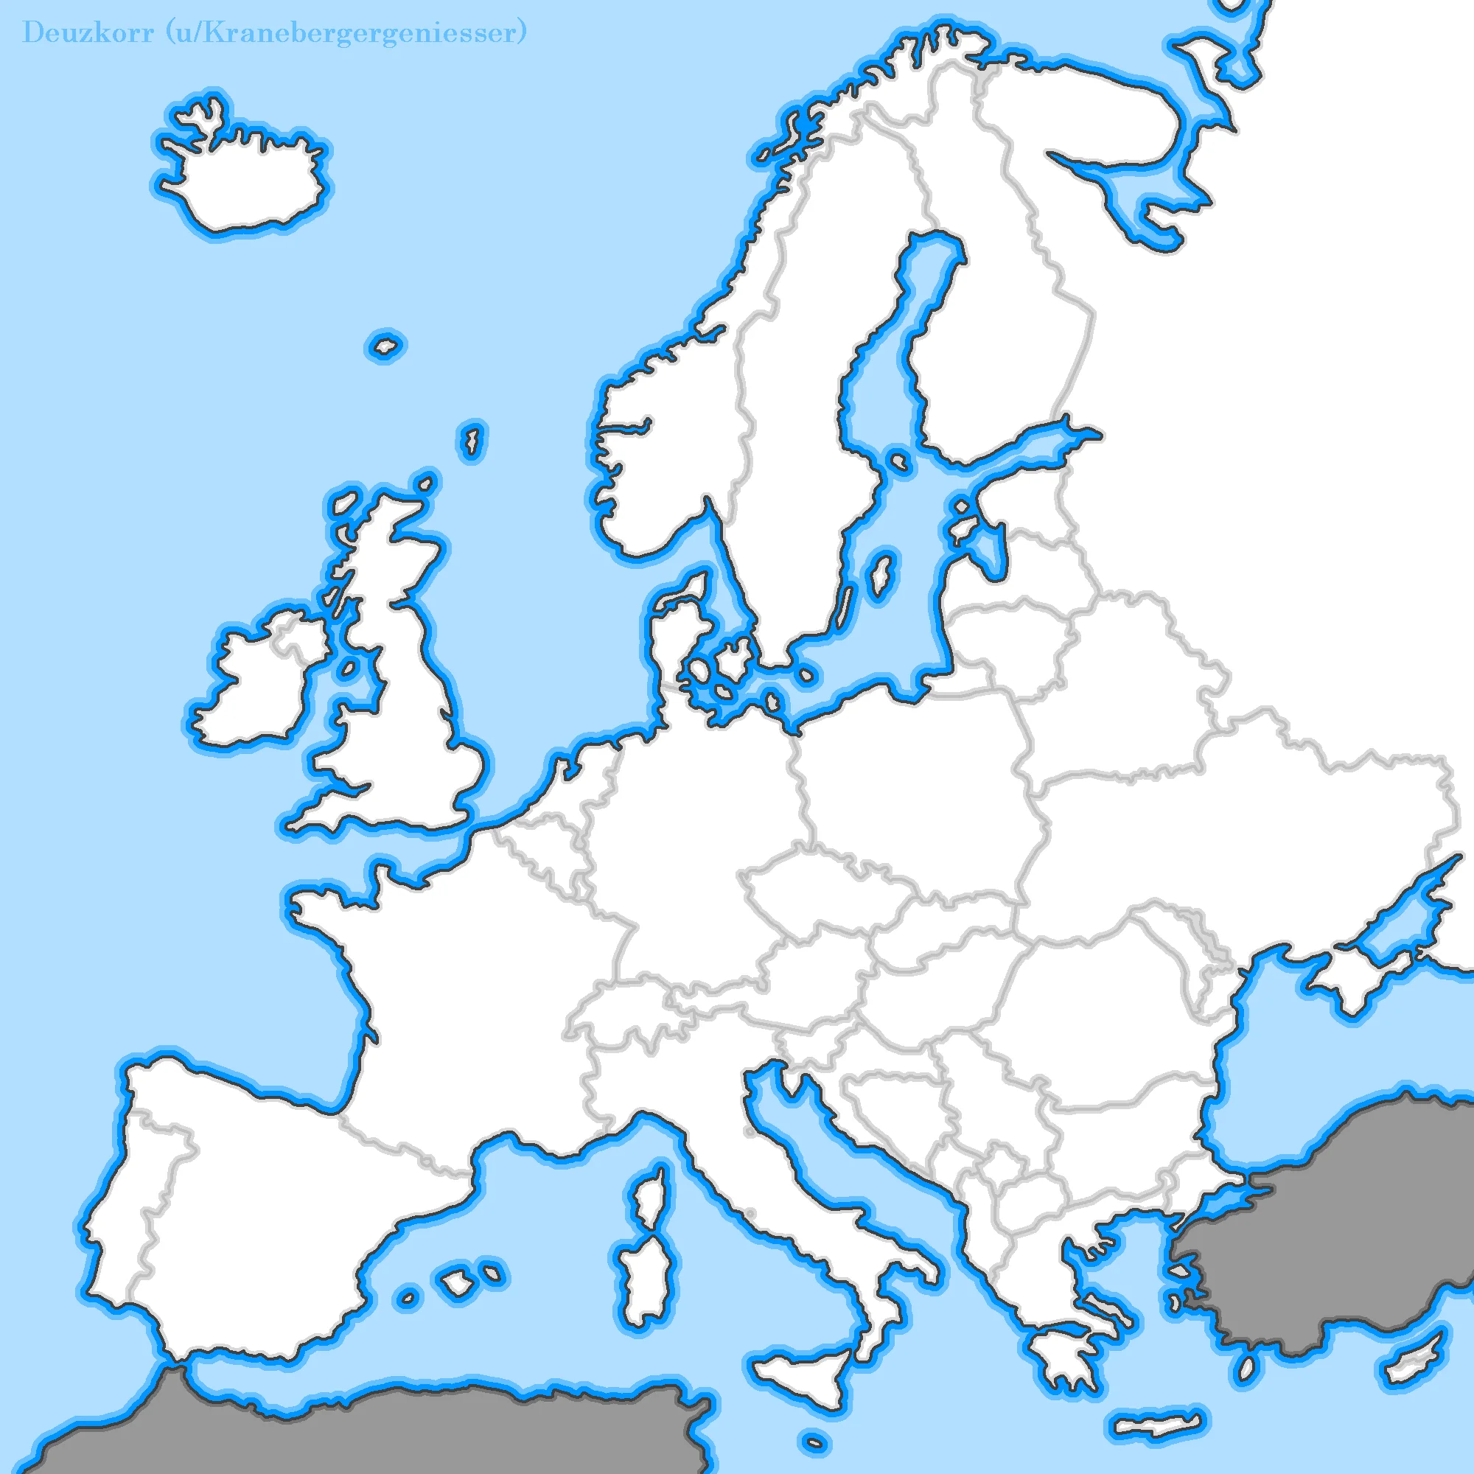

Expansion &
Revenue
2025
€60T
2026
€120T
Total market size – Annual figures
(Nordics, UK, Germany, France, Poland, Spain)
2027
€240T
€98B
Total market: Estimated total collectible debt.
Applicable market: Estimated total soldable debt. 40% of the total collectible debt.
Target market: Target is 2% of the applicable market.
Target capital traded via BidWise: based on our calculations.
Revenue expectation: 2-5% from the traded capital.
€39B
2029
€2.8M
2028
€0.7M
€800M
€150M
€3-6M
2030
+€7M
Notes:
The market for selling overdue receivables is growing.
This map outlines our growth plan, starting in Finland in 2025 and expanding across the Nordics and Central Europe by 2030.
By 2030, BidWise aims to handle 150 million euros in traded capital, generating 3 to 6 million euros in annual revenue through transaction fees.

Slide 7



Founding party
Jarmo Tahvanainen
Over 10 years of experience in debt collection, debt purchasing, and sales.
Based in Lohja, Finland, combining business and technical expertise.
Eppu Hassinen
Skilled in:
Robotics
Machine learning
AI solutions
Risto Teerikoski
Project management expert.
Fluent in Swedish, and leading Nordic expansion efforts.
Notes:
We are a team of university students combining expertise in debt collection, tech, AI, sales and management. With our skills we’re ready to transform this market.

Slide 8


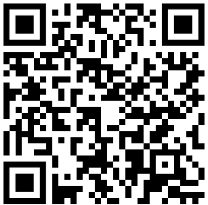


Fast & Simple Way to Trade
To bring this vision to life, we are seeking an investment of €100,000 to develop our platform, onboard partners, and launch in Finland by 2025.
This was super easy!
Tell me about it! Epic!
Scan for more
Eppu Hassinen - Jarmo Tahvanainen - Risto Teerikoski
Notes:
So, BidWise. A fast and simple way to trade overdue receivables.
To make this vision a reality, we are seeking an investment of 100,000 euros.
This will help us develop our platform and successfully launch in Finland by 2025.
If you are interested in making big money, now is your chance.

Slide 9

Metrics
targets

